Slide 1
Final Project Shopping system
William Berthouex
SE450 Object-Oriented Software Development

Slide 2
Project Overview : Major Components
GUI
User Authentication
Product Catalogue
Order Processing
Payment Processing
Event Logging

Slide 3
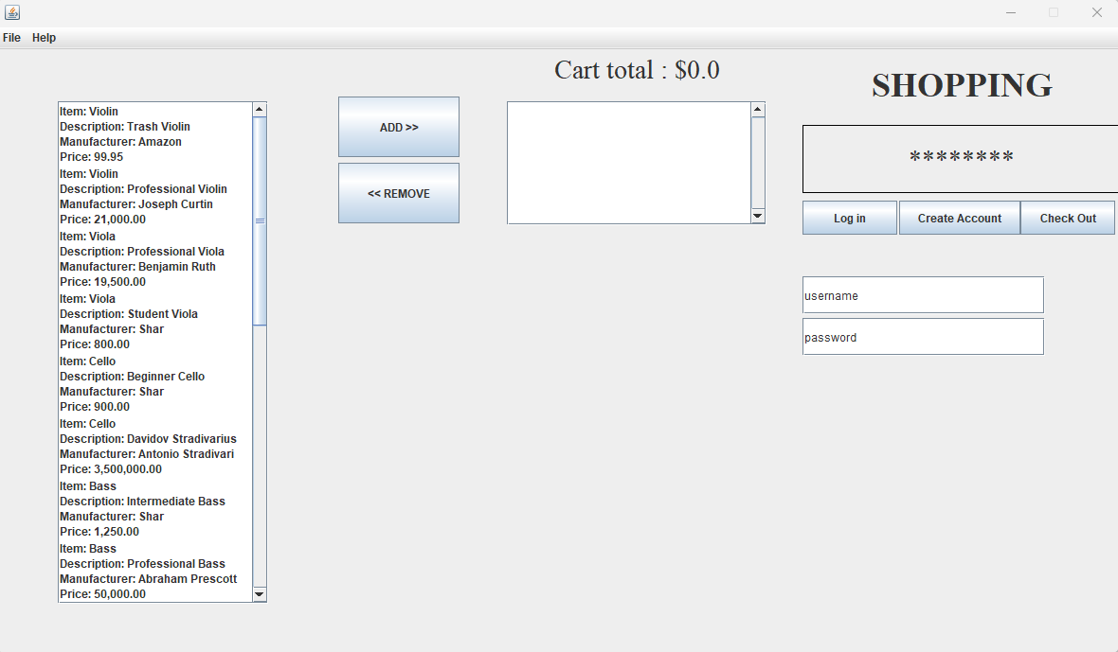
GUI
A simple GUI allows the user to interact with the application.
A user can log in to an existing account, create a new account, or check out a purchase.
Once logged in, a user can add items to their cart and then check out.
Checking out brings up a new window to enter credit card information.
If the credit card passes validation checks, the user receives confirmation of their order.
Notes:
Single Responsibility Principle hardest to adhere to in the application’s code.

Slide 4
Event Logging
A LogWriter class records user actions, various methods called by class files, and errors the application encounters.
The LogWriter is implemented as a singleton.
The LogWriter is instantiated in a static block before anything else.
The LogWriter is modeled after the Logger in the java.util.logging package.
The log is stored in a file in the project root directory. This log is not overwritten and subsequent instances of the application will append their logs to the existing log file.

Slide 5
Product Catalogue
The Catalogue is implemented as a singleton pattern.
It is instantiated at the start of the application’s runtime.
Populates the catalogue with a selection of items read from a file.
Notes:
I made a connection between storing information for products, users, and orders and so thought it was a good candidate for a common interface.
The Catalogue is designed such that items could be added directly with code after instantiation.

Slide 6
User Authentication
When a user enters a username and password into the corresponding fields in the GUI, the application checks these against a “database” of existing users.
If the username and password match, the user is allowed to log in. A successful login displays the message “Welcome <USERNAME>!” on the GUI.
If there is no match, nothing happens.
If a user creates a new account, the password is associated with their chosen username.
Notes:
Following best practices, the plaintext password is never stored. Only a hashed password is stored.
A UserDatabase class – implementing the Catalogue Interface – maintains records of all users.

Slide 7
Payment Processing
A PaymentProcessor class simulates credit card validation.
Simple checks ensure that the credit card number, expiration date, and security code are of an acceptable length (this is only a simulation and is not intended to accurately represent credit card validation).
After a credit card passes validation checks, the application proceeds to Order Processing.
It is possible for a credit card to fail validation checks, at which point the order is cancelled.

Slide 8
Order Processing
An OrderProcessor class handles the creation of new orders.
A new order is only truly created after a user’s credit card has passed validation.
The new order is added to the Order Database and the user receives a confirmation message and order number.

Slide 9
Design Decisions

Slide 10
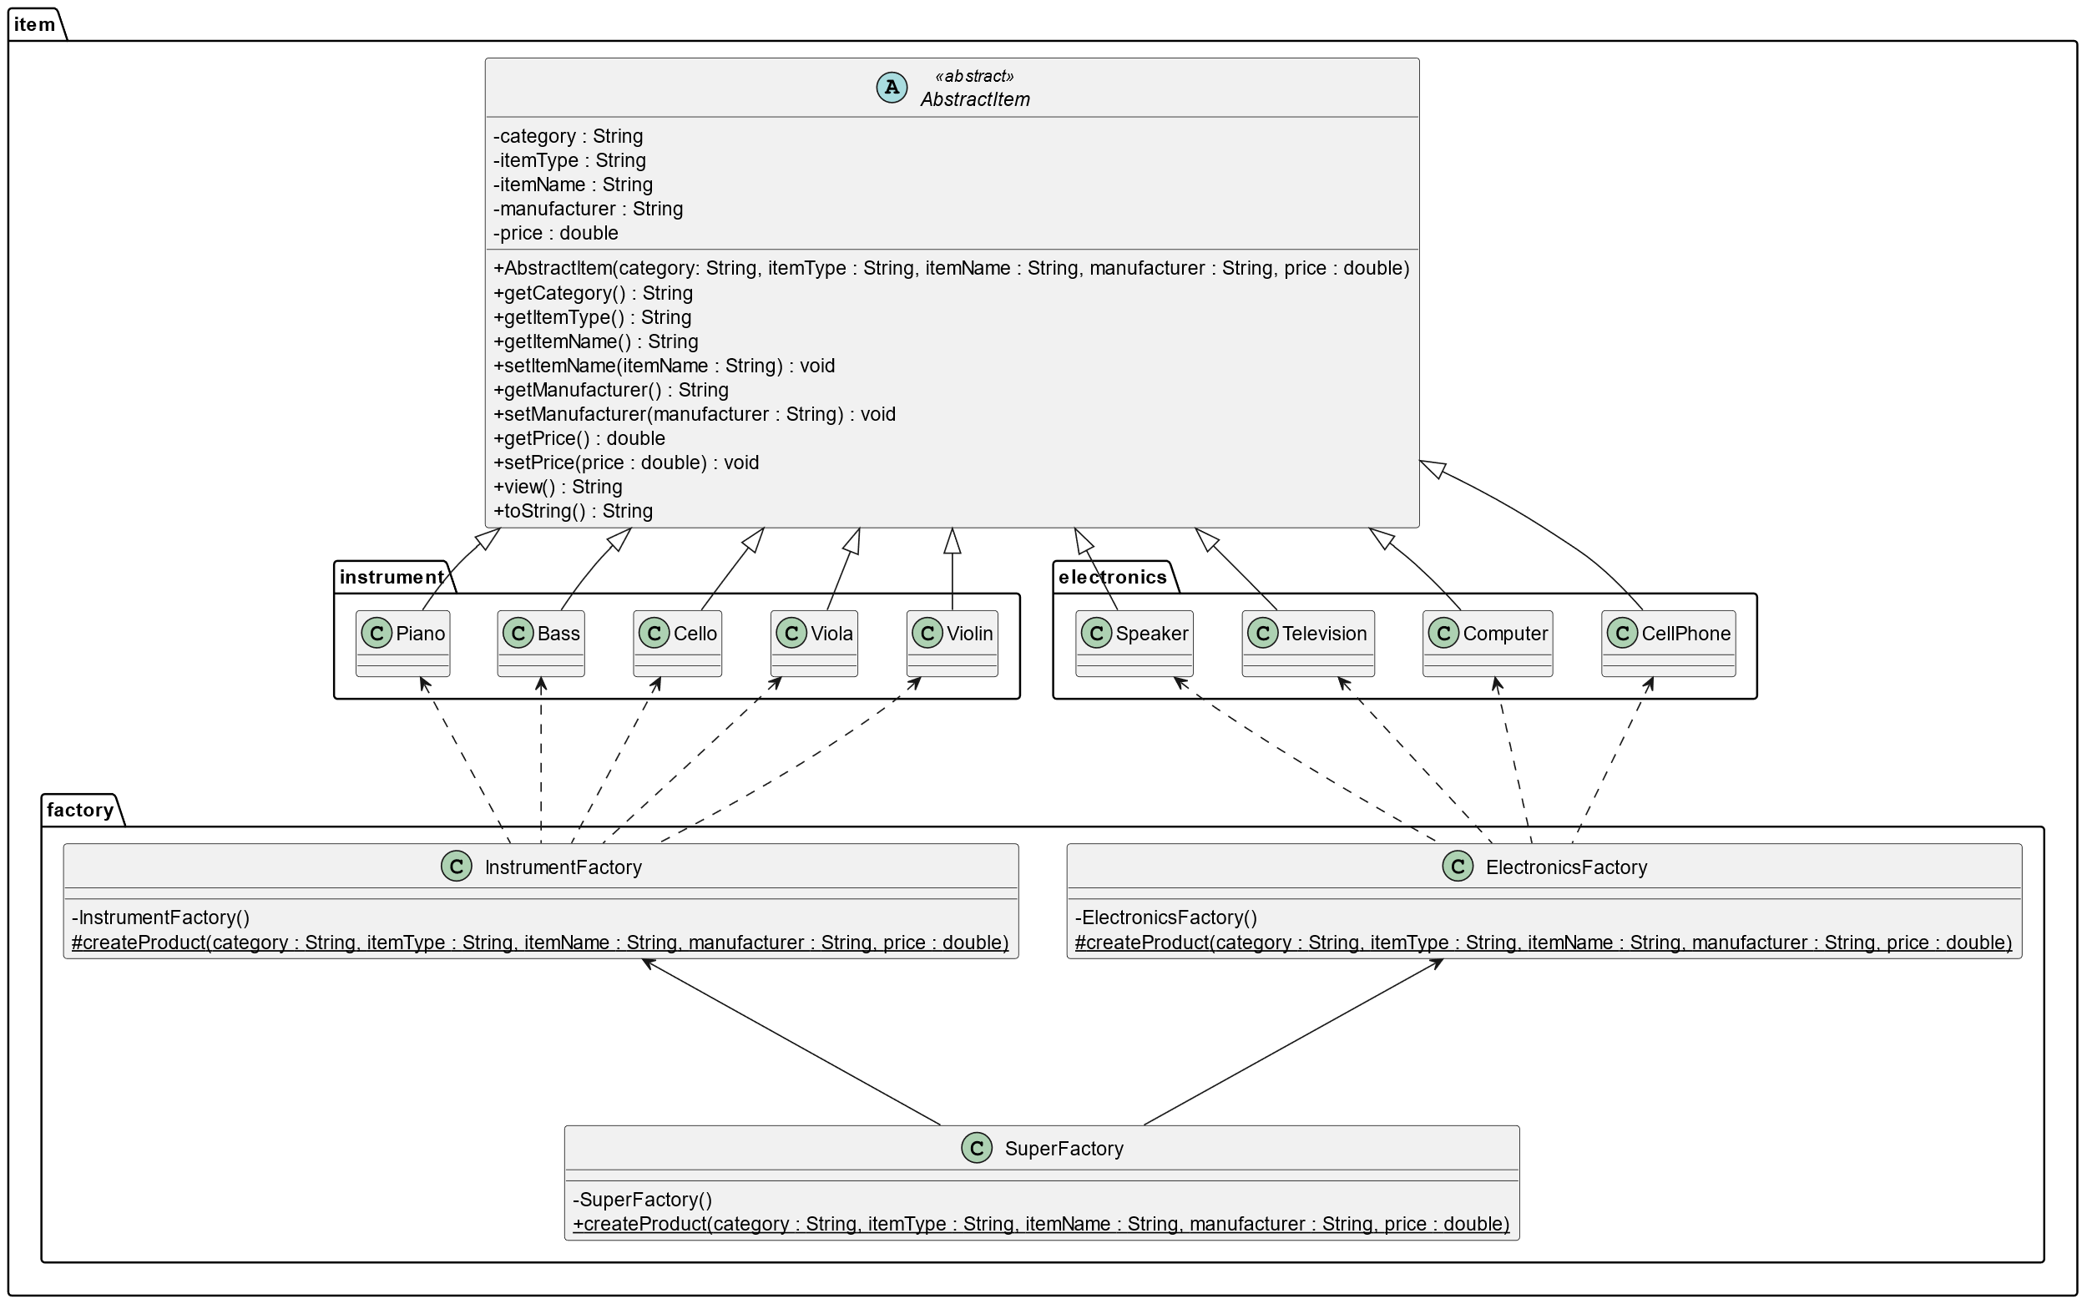
Item Implementation
AbstractItem class is super-class for all items.
SuperFactory uses sub-factories to generate items. It is not an abstract class or interface.

Slide 11
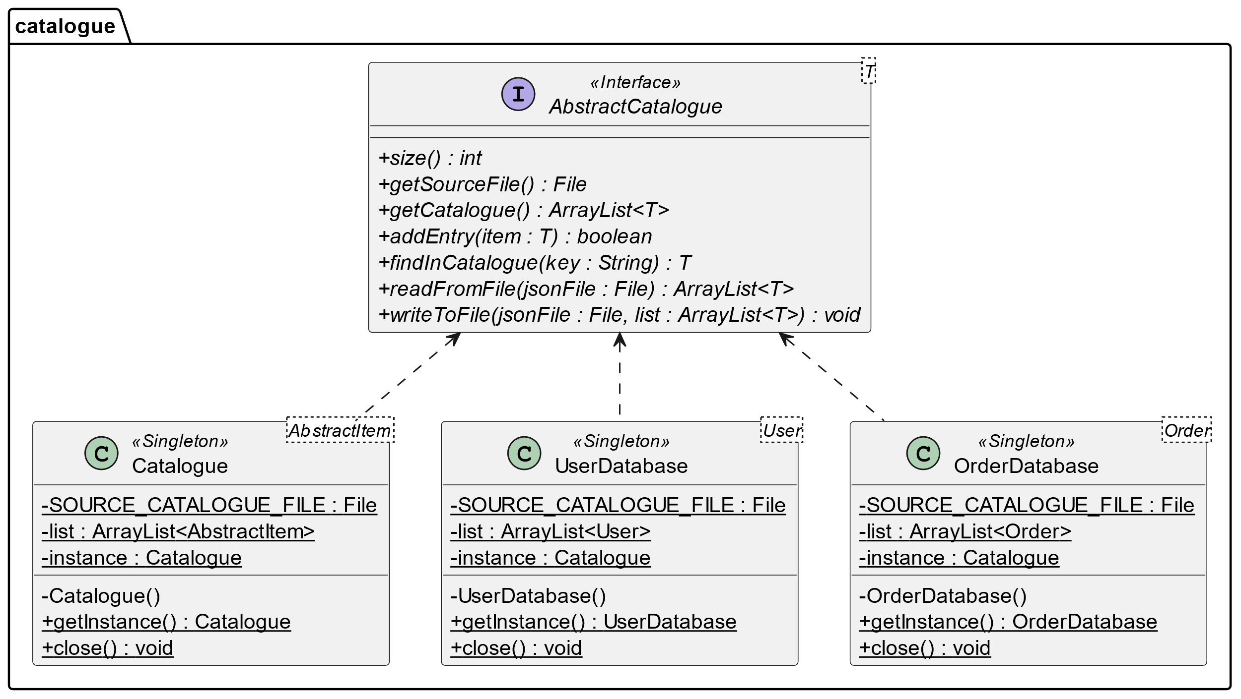
Catalogue Implementation
The operations required to maintain a User database, Order database, and Product Catalogue were similar. So an interface served all three.
Each is implemented as a singleton.

Slide 12
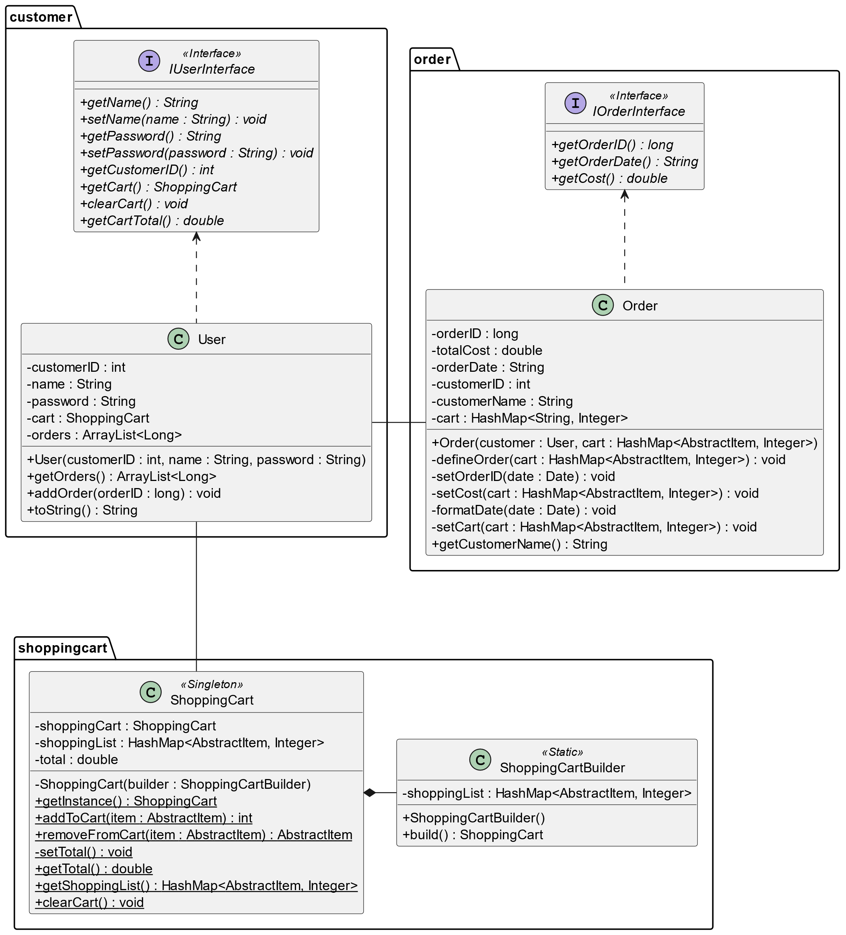
User, Order, Shopping Cart
A User class implements a UserInterface.
It keeps a list of Order numbers of orders that are associated with that user.
Orders are not generated until a User checks out their purchase.
A Shopping Cart is generated with a User. Only one instance may exist at any one time.

Slide 13
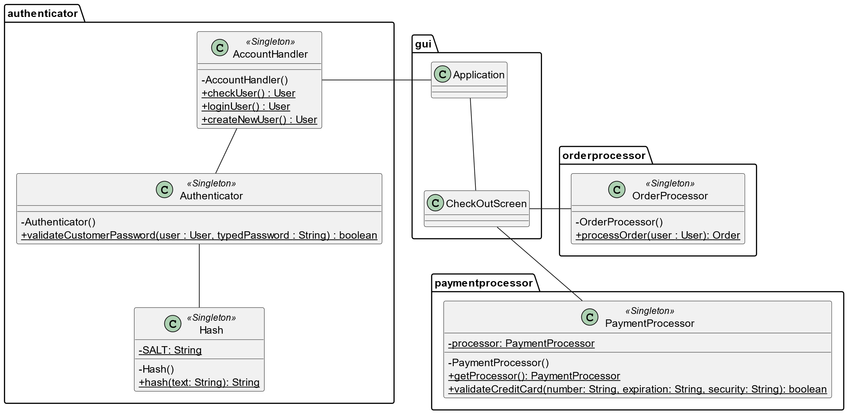
Authentication and Payment Processing
When a user clicks one of the buttons in the GUI, the application calls the AccountHandler class.
The AccountHandler class handles validating a User’s credentials and creating a new user.
The PaymentProcessor validates the User’s credit card information and then the OrderProcessor generates the order.

Slide 14
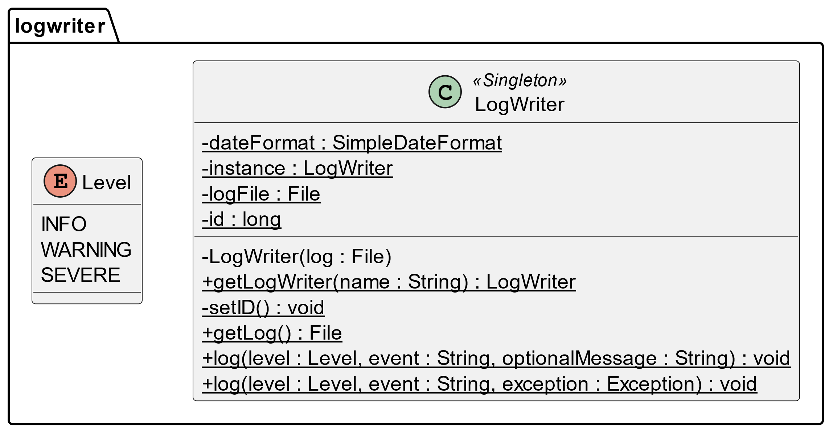
LogWriter Implementation
The LogWriter logs events to a log file.
Subsequent instances of the application will use the same log file.

Slide 15
Application Demonstration

